Slide 1
HEART DISEASE PREDICTION USING CLASSIFICATION ALGORITHMS
Python Intermediate Class @Group 2

Slide 2
Introduction
Machine learning is a subset of artificial intelligence in the field of computer science that often uses statistical techniques to give computers the ability to "learn" with data and make predictions (Wikipedia).
Prediction involves some variables or fields in the data set
to predict unknown or future values of other variables of interest.
We are using data science to make heart disease predictions using the heart disease dataset from UCI ML Repository.

Slide 3
Heart Disease Dataset
This dataset originally contains 76 features of which only 14 of them were used for the prediction.
'Age', 'Sex', 'RestBP - Resting blood pressure ', 'Chol - serum cholestoral', ‘Fbs - fasting blood sugar', 'RestECG - resting electrocardiographic results ', 'MaxHR - maximum heart rate achieved ', 'ExAng’, 'Oldpeak - ST depression induced by exercise relative to rest ', 'Slope - the slope of the peak exercise ST segment', ‘Ca - number of major vessels', 'Thal', 'ChestPain’, ‘AHD - diagnosis of heart disease’
Notes:
RestBP - resting blood pressure (in mm Hg on admission to the hospital)

Slide 4
Algorithm Description
Name: Random Forest Algorithm
It is a supervised learning algorithm used both for classification and regression.
Supervised algorithms fed with both input and desired output.
Notes:
RestBP - resting blood pressure (in mm Hg on admission to the hospital)

Slide 5
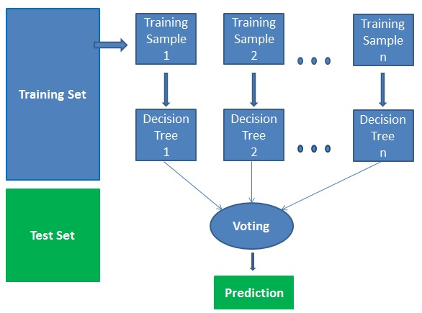
Algorithm Description
It works in four steps:
Select random samples from a given dataset.
Construct a decision tree for each sample and get a prediction result from each decision tree.
Perform a vote for each predicted result.
Select the prediction result with the most votes as the final prediction.
(Source: datacamp.com)
Notes:
RestBP - resting blood pressure (in mm Hg on admission to the hospital)

Slide 6
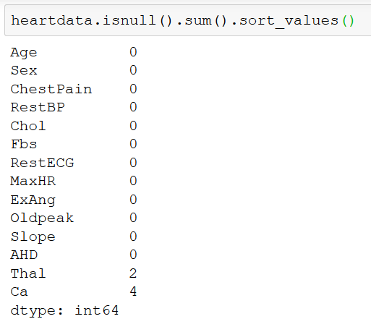
Explorative Data Analysis
Data Cleaning
Missing data
Non-numeric to numeric values
Data Visualization
Notes:
RestBP - resting blood pressure (in mm Hg on admission to the hospital)

Slide 7
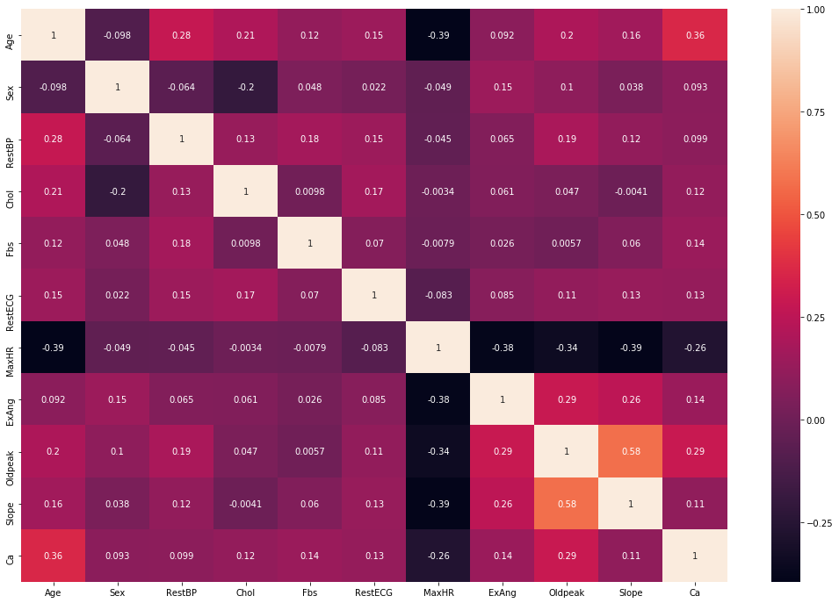
Data Visualization
Notes:
RestBP - resting blood pressure (in mm Hg on admission to the hospital)

Slide 8
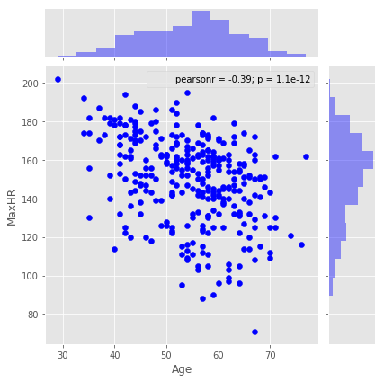
Data Visualization
Notes:
RestBP - resting blood pressure (in mm Hg on admission to the hospital)

Slide 9
Model Building and Training
Data Splitting
X_train, X_test, y_train, y_test = train_test_split(newdata, target, test_size=0.2)
Model Initialization
clf = RandomForestClassifier(n_estimators = 40, random_state = 101)
Model Training
clf.fit(X_train,y_train)
Notes:
RestBP - resting blood pressure (in mm Hg on admission to the hospital)

Slide 10
Data Interpretation
Accuracy Score: 86.89%
Given 10000 situations – 8689 correct predictions
Notes:
RestBP - resting blood pressure (in mm Hg on admission to the hospital)

